Slide 1

Faculty of Digital Transformation
Educational program: Big Data and Machine Learning
Subject area: 01.04.02 Informatics and Applied Mathematics
Report of Laboratory task 2
“Oil and gas field tasks classification”
Ivanchik Elizaveta, J4234c
Tsaplina Ekaterina, J4233c
Saint-Petersburg
2023

Slide 2
Exploratory data analysis
Non-null count of data in train dataset
Column | Non-null count
work_name | 716,067
generalized_work_class | 296,858
global_work_class | 296,858
upper_works | 25,039

Slide 3
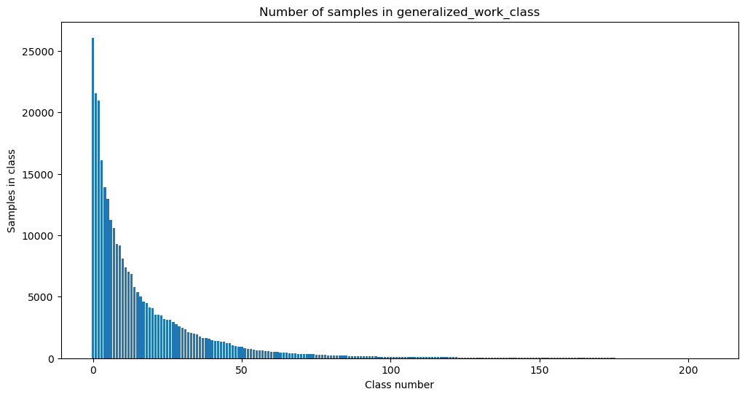
Exploratory data analysis: Classes balance

Slide 4
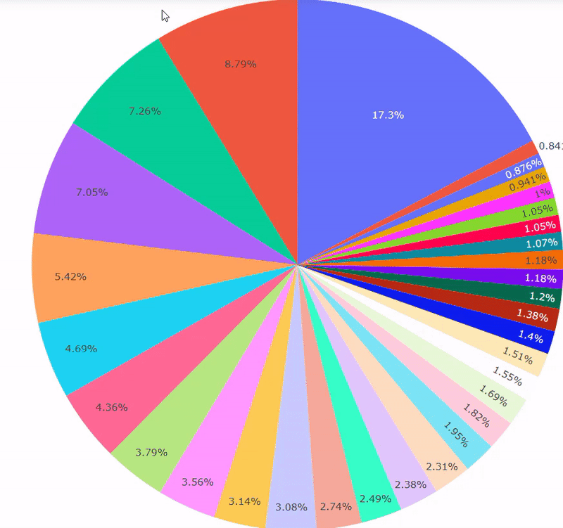
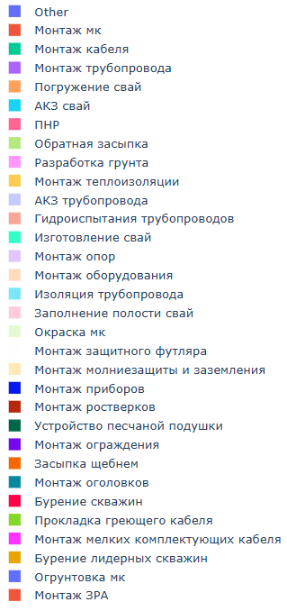
Exploratory data analysis: Classes balance
Number of samples in each class of generalized_work_class

Slide 5
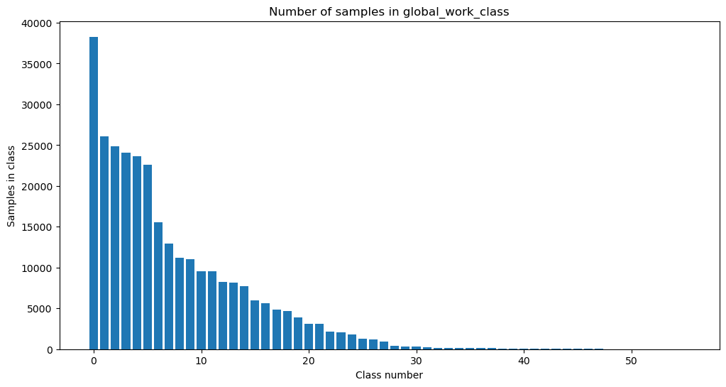

Exploratory data analysis: Classes balance

Slide 6
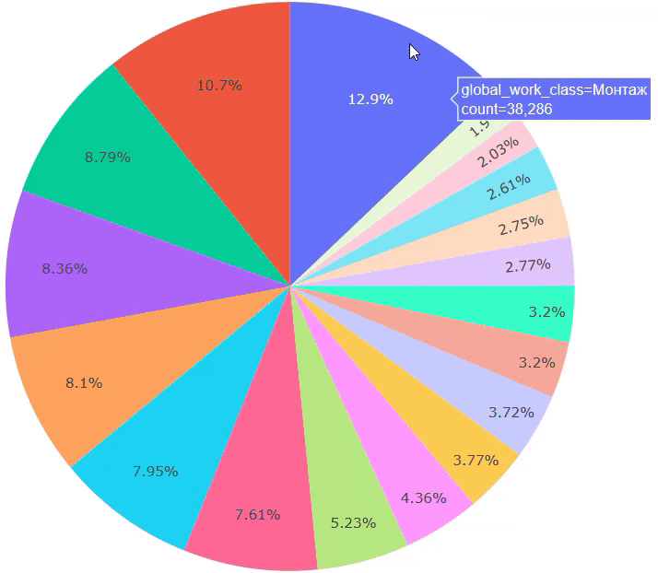
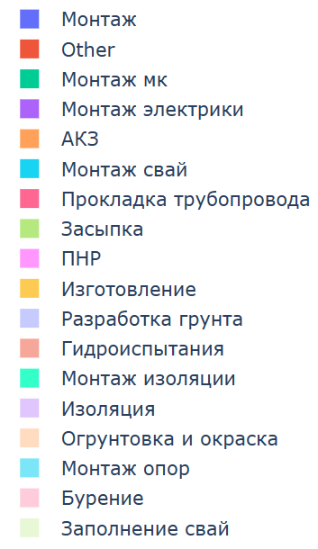
Exploratory data analysis: Classes balance
Number of samples in each class of global_work_class

Slide 7
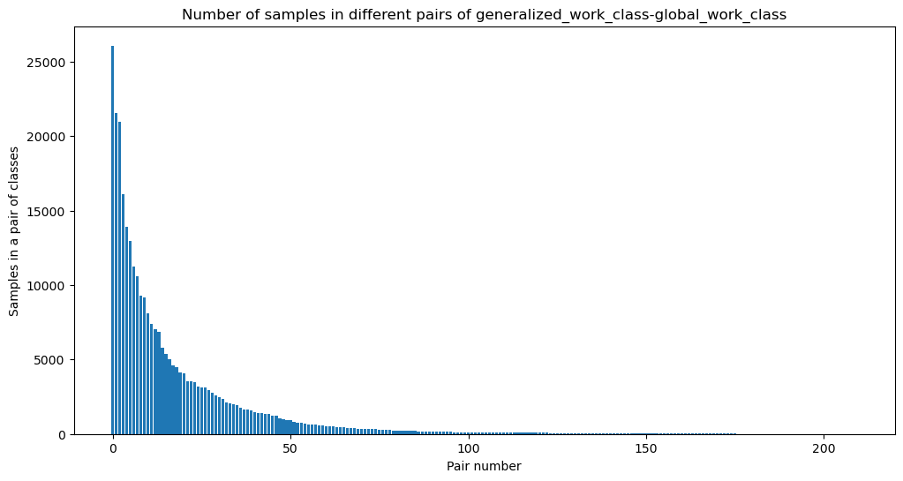
Exploratory data analysis: Classes balance

Slide 8
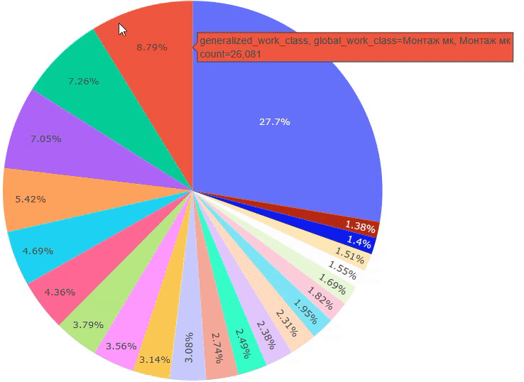
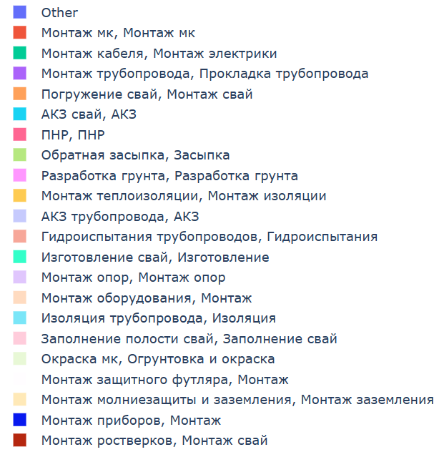
Exploratory data analysis: Classes balance
Number of samples in each pair of generalized_work_class & global_work_class

Slide 9
Exploratory data analysis: Classes number
Number of unique values in columns
Column / columns | Count
global_work_class | 56
generalized_work_class | 207
generalized_work_class & global_work_class | 210

Slide 10
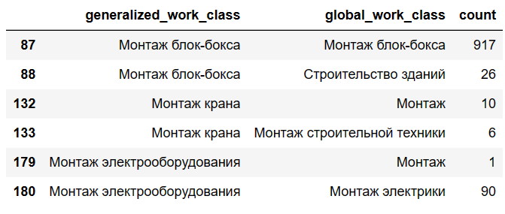
Exploratory data analysis
Table 3. Cases of generalized_work_class that have several variants of global_work_class
Total quantity in labeled dataset: 0.35%
Notes:
Около 1000 записей из 300,000 (0.35% датасета)

Slide 11
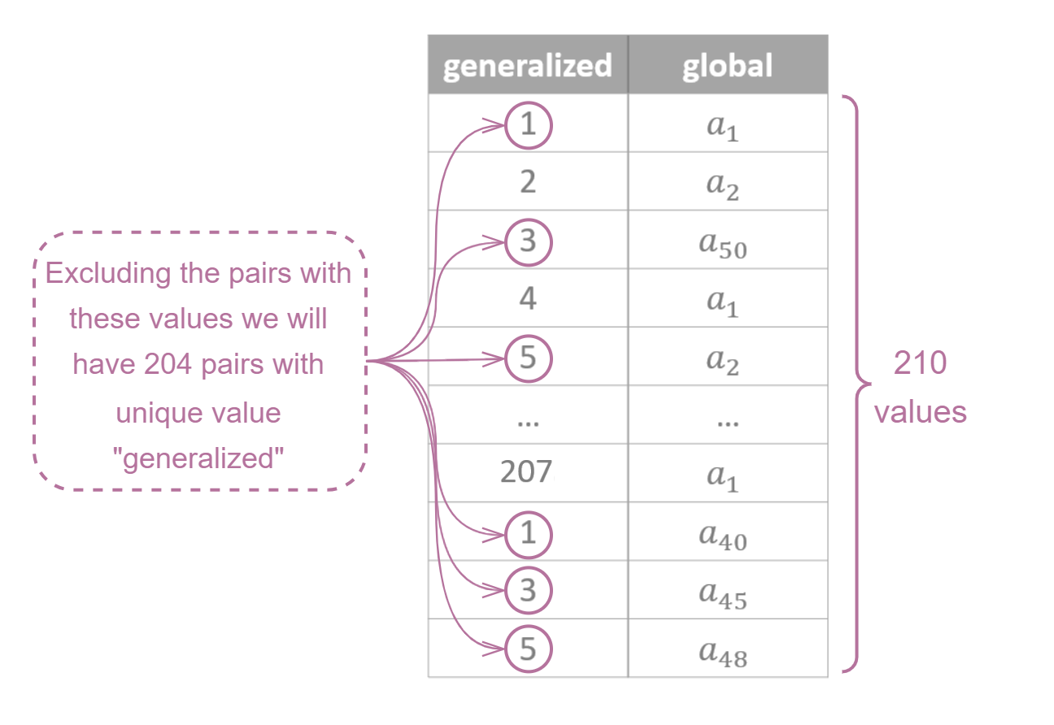
Exploratory data analysis
Scheme of unique pairs generalized_work_class & global_work_class

Slide 12
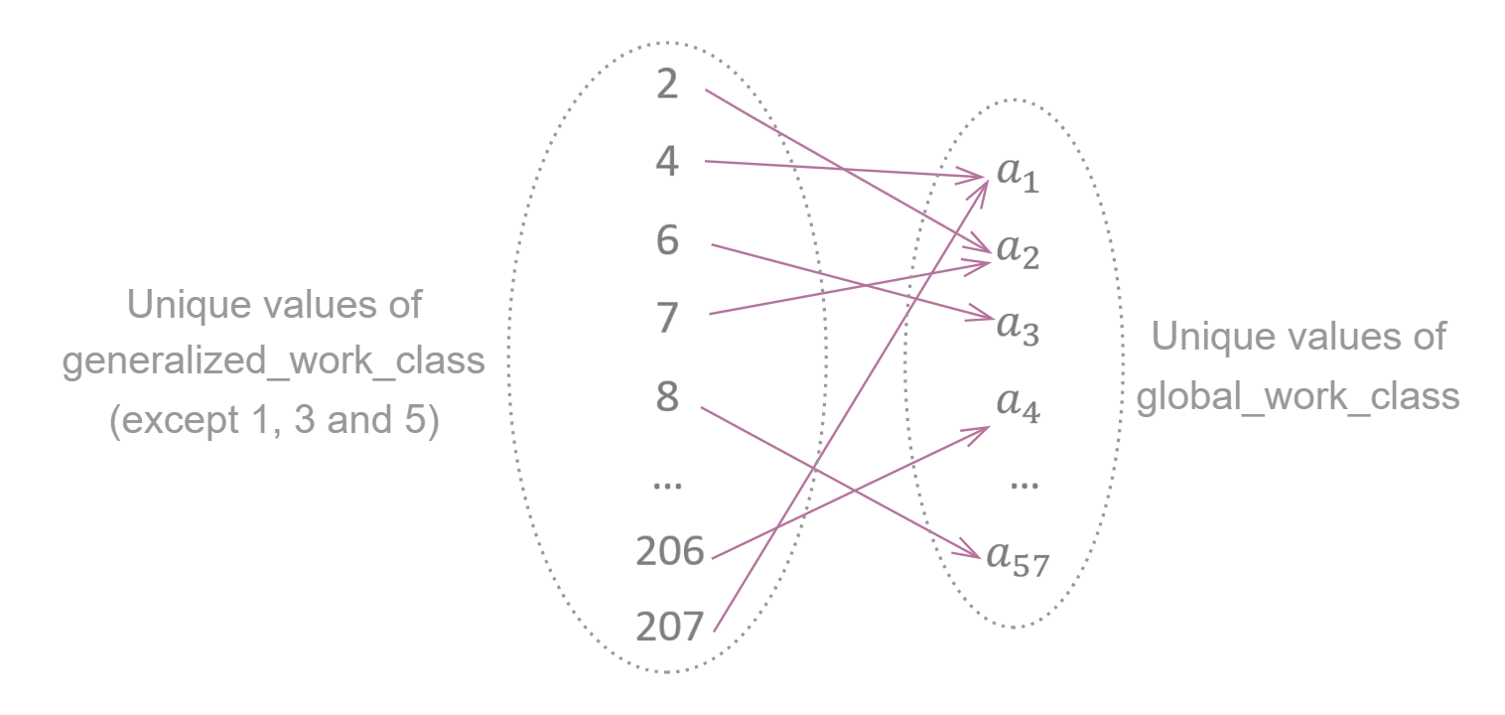
Exploratory data analysis
Surjective relation between generalized_work_class & global_work_class

Slide 13
Strategy formation
Hypothesis: can an aforementioned surjective relation be used to predict global_work_class, supposing that the generalized_work_class has been predicted correctly?
Advantages:
If it can be used, then the prediction time and resources for global_work_class will be greatly reduced.
Problems:
If test dataset data distribution differs from the one presented in train, then the predictions for global_work_class won’t be correct. If the distribution is guaranteed, then the method will provide huge benefit.

Slide 14
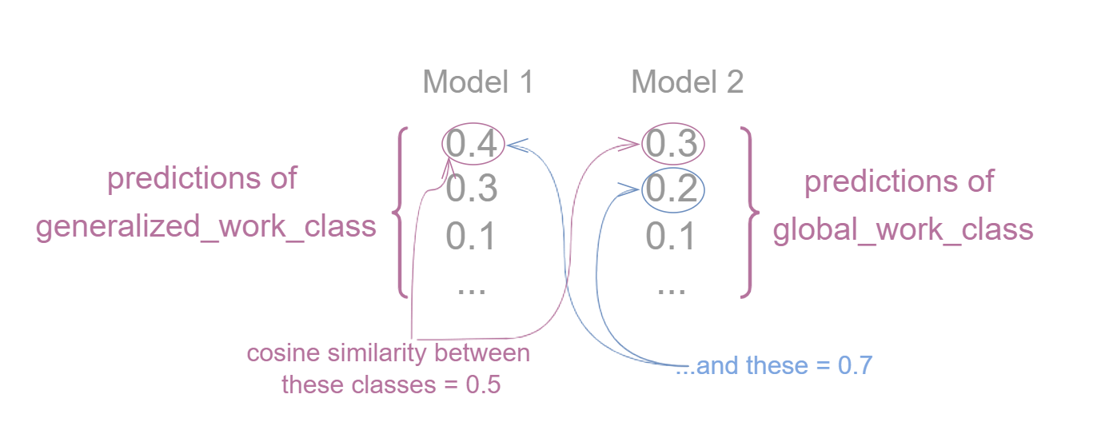
Strategy formation
Other ideas: create embeddings and measure cosine similarity for classes in global_work_class and generalized_work_class to capture the relation between them. Use similarities to select the global_work_class based on generalized_work_class along with the independent prediction of global_work_class.

Slide 15
Strategy formation
Other ideas: create embeddings and measure cosine similarity for classes in global_work_class and generalized_work_class to capture the relation between them. Use similarities to select the global_work_class based on generalized_work_class along with the independent prediction of global_work_class.
Advantages:
Calculations of embeddings and similarity are only needed to be done once (207 + 56 embeddings and 207*56 calculations of cosine similarity).
Problems:
If different global work classes have similar names then they will be close to each other in embedding space and the cosine similarity of some generalized work classes will also be similar to them.

Slide 16
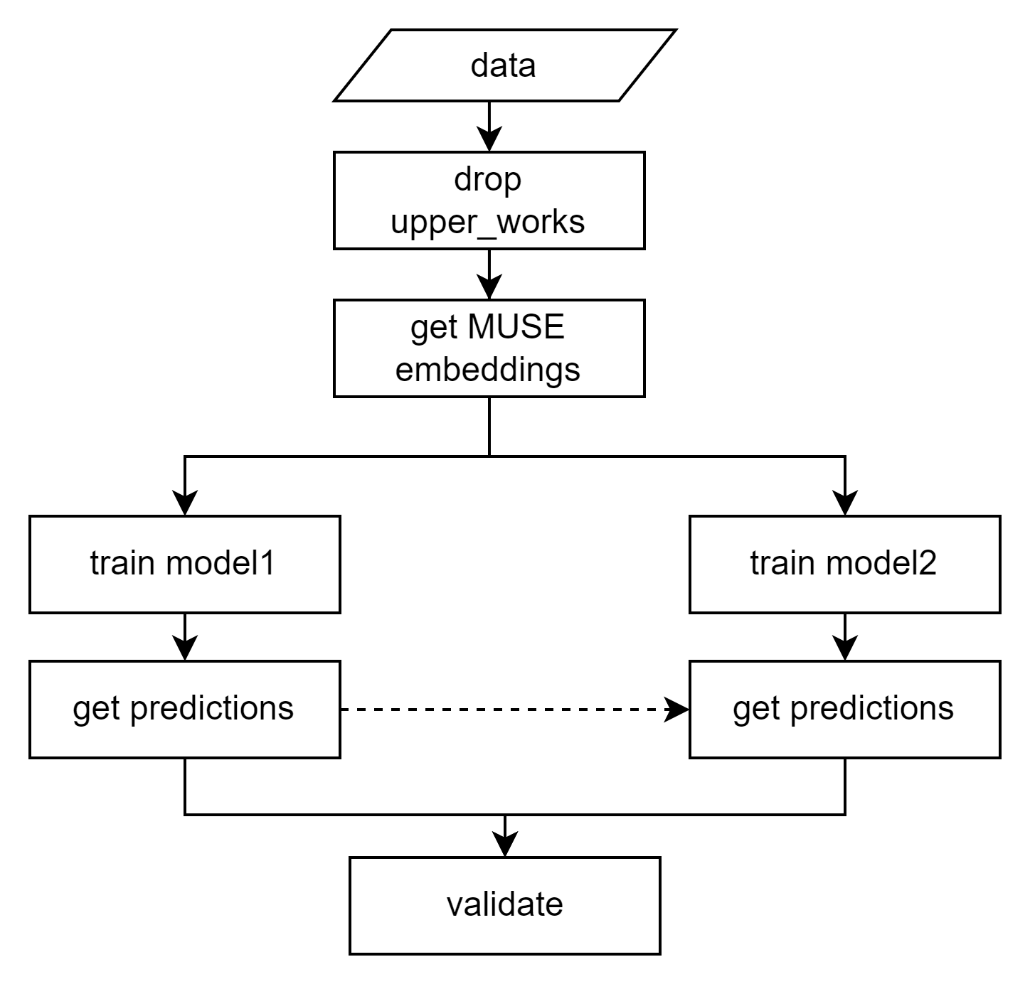
Models overview
Scheme of generalized algorithm

Slide 17
Model 1: Logistic regression

Slide 18
Logistic regression
Reasons for implementation:
Simple and therefore fast algorithm;
The aim is not to get perfect result but to understand the problems and mistakes related to prediction;
The purpose is also to accept or reject the first hypothesis.

Slide 19
Logistic regression: Validation results
Logistic regression validation metrics
Feature/ metric | F1-macro score | F1-micro score
Predictions for generalized work class | 0.792 | 0.980
Predictions for global work class | 0.823 | 0.976
Number of mistakes: 447 (validation size = 14843)

Slide 20
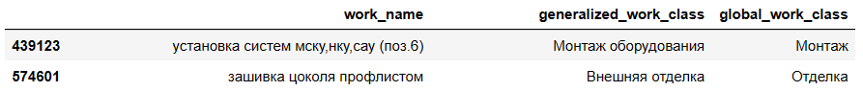
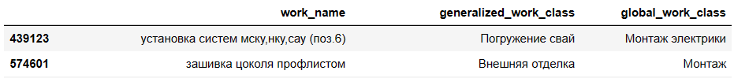
Logistic regression: Mistakes analysis
Original dataset classes:
Predicted classes:

Slide 21
Logistic regression: Hypothesis testing
Comparison of metrics: independent models and with relation from hypothesis
Feature/ metric | F1-macro score | F1-micro score
Predictions for global work class | 0.823 | 0.976
Predictions for global work class by generalized class | 0.836 | 0.982
Number of mistakes: 303 (validation size = 14843)

Slide 22
Model 2: K-Nearest Neighbors

Slide 23
K-Nearest Neighbors
Reasons for implementation:
In essence, the closer the embeddings to each other the more similar by context they are;
With default parameters had a CV score for F1-macro score not less than Random forest (0.93);
Fast algorithm (even faster than Random Forest and Logistic regression)
Notes:
Здесь соседи оказались даже быстрее рэндом фореста при cross validation (при получении скора в 0.93)

Slide 24
K-Nearest Neighbors: Results analysis
Prediction metrics
Feature/ metric | F1-macro score | F1-micro score
Predictions for generalized work class | 0.972 | 0.994
Predictions for global work class | 0.994 | 0.995
Number of mistakes in validation data: 82 (validation size = 14843)

Slide 25
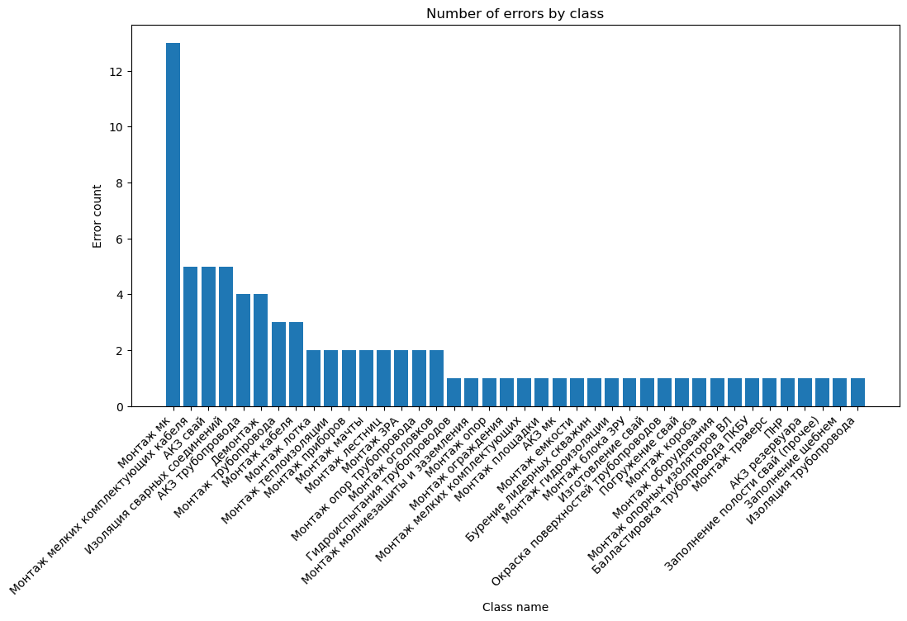
K-Nearest Neighbors: Mistakes analysis

Slide 26
K-Nearest Neighbors: Hypothesis testing
Comparison of metrics: independent models and with relation from hypothesis
Feature/ metric | F1-macro score | F1-micro score
Predictions for global work class | 0.994231 | 0.995419
Predictions for global work class by generalized class | 0.994038 | 0.995284

Slide 27
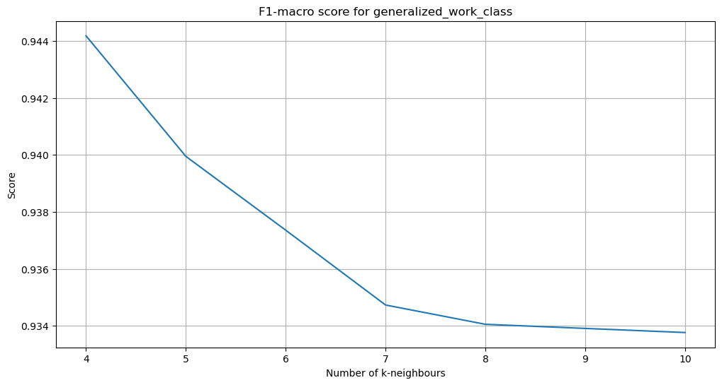
K-Nearest Neighbors: Fine-tuning
Where CV = 5

Slide 28
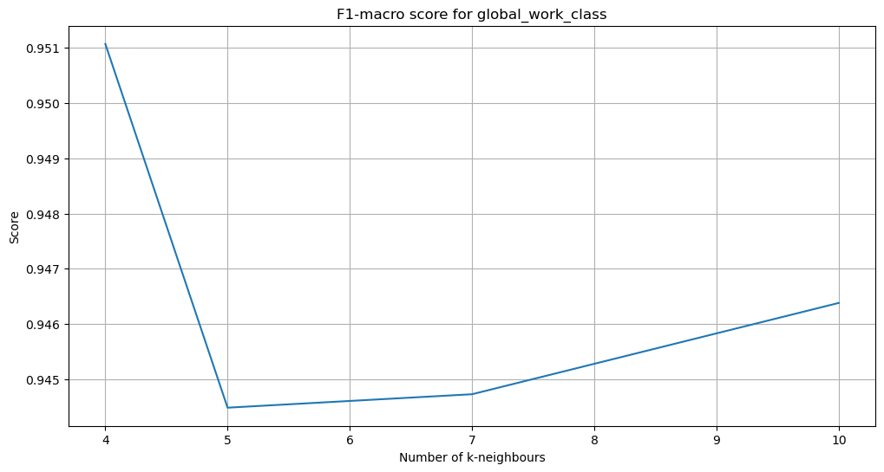
K-Nearest Neighbors: Fine-tuning
Where CV = 5

Slide 29
K-Nearest Neighbors: Validation results
Metrics for knn algorithms
Metric / KNN | 5-knn* for generalized | 4-knn for generalized | 5-knn for global | 4-knn for global
F1-macro | 0.972141 | 0.972142 | 0.994231 | 0.993522
F1-micro | 0.994476 | 0.994543 | 0.995419 | 0.995419
Averaged f1-macro in CV | 0.939949 | 0.944180 | 0.944483 | 0.951072
*5-knn is knn, where number of neighbours = 5

Slide 30
K-Nearest Neighbors: Test results
Resulting metrics
Feature/ metric | F1-macro score | F1-micro score
Predictions for generalized work class | 0.971533 | 0.995730
Predictions for global work class | 0.985600 | 0.996387
Predictions for global work class by generalized class | 0.985680 | 0.996367
Notes:
Predictions for global work class by generalized class - разумно применять, так как knn затрачивает время на предсказание (а не на обучение) в отличие от других моделей

Slide 31
Ideas for results improvement
More accurately define classes by aggregating them;
Working with probabilities in logistic regression - selecting the threshold empirically;
Working with probabilities in logistic regression - threshold selection using an additional model;
Using spellchecker (JamSpell, etc).

Slide 32
Summary of results and conclusions
Exploratory analysis showed that classes are greatly imbalanced;
The generalized class can be used to predict global class;
KNN yielded better results than logistic regression;
KNN was faster than logistic regression and random forest;
The first hypothesis turned out to be true;
The implementation of cosine similarity proved to be irrelevant to the problem.

Slide 33

THANK YOU FOR YOUR TIME!

